Slide 1
A NEW WAY TO MENTOR
Latrice Puckett

Slide 2
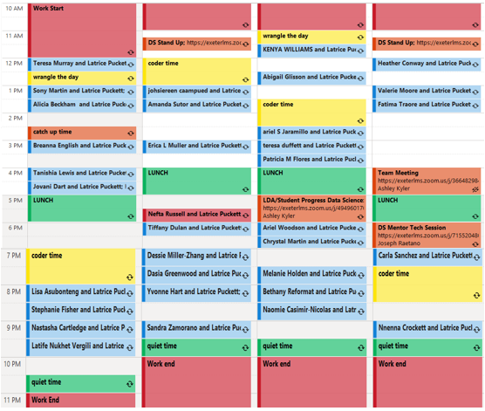
Problems with the current model
Back to back meetings, no real time for direct student help
No distinct time for self improvement or lesson examples
No dedicated time for grading, chasing, welcomes
Hard to reschedule meetings and give student freedom to navigate personal life
NO. TIME. BURN. OUT
Cannot focus on curriculum mistakes, fix major recurring issues
Trying to teach, help students on too many classes at once. Surface level understand that resets every three weeks
Hard to keep up with chasing when near/ over 40 students
Very little comms between front and back week teams, unsure of the recurring problems/ students for each end of the week
Students have one mentor and may never reach out on mentor’s day off
some students NEVER interact with a specific mentor (they ultimately miss out on that mentors knowledge and resources)
Student complaint: learning from static pages, outdated videos, incorrect lesson info with little guidance/
Cannot always provide an extra zoom OR stuck zooming needy students all day, cannot man slack channels as readily

Slide 3
What we hope to see
Students get as many sources of information (mentors) and resources as they can throughout the program
Mentors flex their expertise and strengthen their weak spots over the life of their career here
Each mentor is better able to reach everyone, we improve pass rates
Program is able to keep up with exponential growth of program
Program is able to stay competitive in the tech education world
Students excel in the program and find relevant work quickly after

Slide 4
Ways to Achieve This
Change the way we interact with students:
Remove the 30-minute meetings for each student, replace with office hours for each class
Remove pairing mentors with specific students, replace with open mentorship
Assign mentors to specific classes for extended periods of time (multiple mod cycles)
Give mentors joint responsibility for student contact and progress (shared pass rates)
Set up grouped communications between mentors sharing a class and students

Slide 5
THE BENEFIT
More chasing overall but less work individually= No Burn Out
Mentors focus on three subjects and have better direction on what examples to build
students see a variety of teaching styles, freedom in schedule, better help through the entire week
No one mentor is overloaded with needy students, every class has at LEAST two mentors
More structured day with better availability
New expectation set on students to keep pace in the program and cooperate with group.
Students prefer learning from a person rather than a page of words, this fulfills that criticism
The students that currently do poorly in the program due to availability and resources have better chance of finding a mentor that works for them
Works into the “No Chase” model currently running

Slide 6
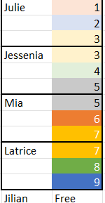
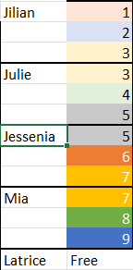
Four types of class assignments
3 classes each
Class overlap in order of number
Free person mans slack/ IT troubleshoot
3-mod (9 weeks locked in)
5-mod(15 weeks locked in)
Mentors move down list/ up classes
3/5-mod

Slide 7
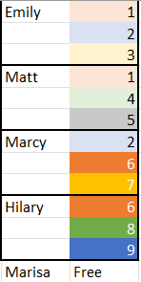
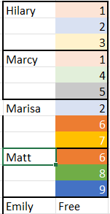
Four types of class assignments
3 classes each
Class overlap based on program needs
Free person mans slack/ IT troubleshoot
3-mod (9 weeks locked in)
5-mod(15 weeks locked in)
Dynamic class changes based on needs
Can choose strong/ weak points in knowledge to practice
3/5-mod

Slide 8
Free Mentor: Anything but free
Does all the chasing?
Works on grading, checking/ updating curriculum issues, also reaching out to LDA/ failing/ behind students
Takes general questions and IT issues, jumps on for stray zooms, really bad OS issues
Picks up class as third mentor when gets too saturated

Slide 9
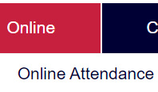
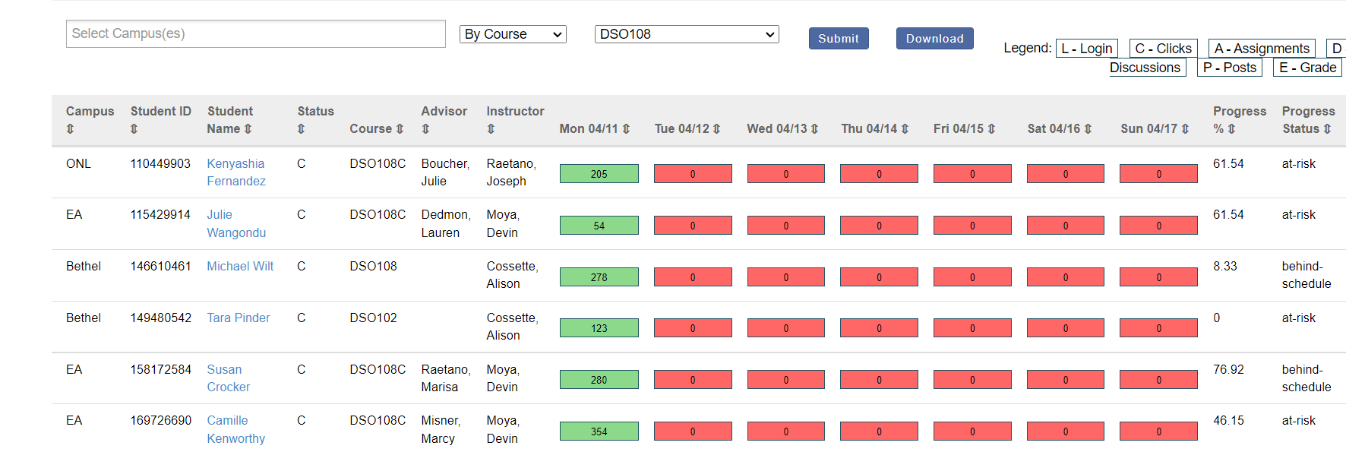
A new way to interact with connect
“online -> online attendance”
Sort by one class
More in-depth info at a glance!
Still click student and add notes

Slide 10
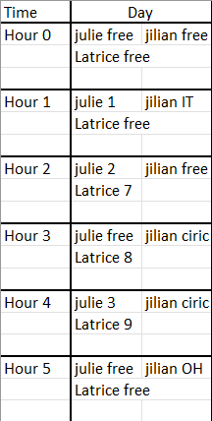
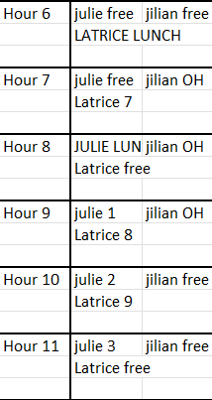
A Typical Day
Initial switch: Mentors communicate and stagger hours of lunch, OH and slack manning
New hours are SET, same each day, even after changing classes
Mentor days off covered by other mentors (or no office hours?)

Slide 11
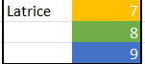
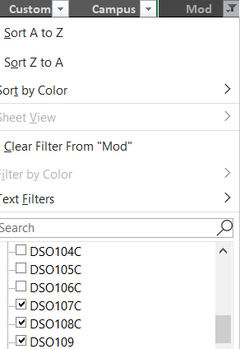
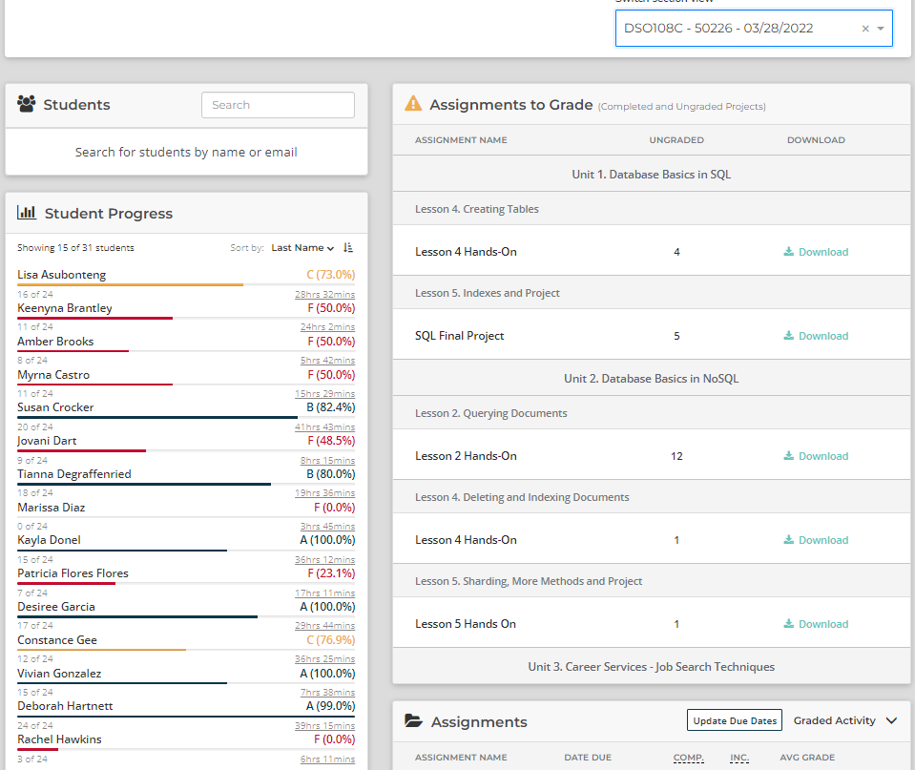
A Typical Day :Latrice
Start day with mentor dashboard: sorted by my CLASSES, check needs grading, LDA, lessons completed as usual.
Move into LMS by CLASS, check behind/ failing students, grade papers, reach out for retakes in the FOUR FREE hours (man slack)

Slide 12
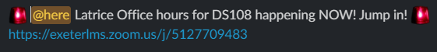
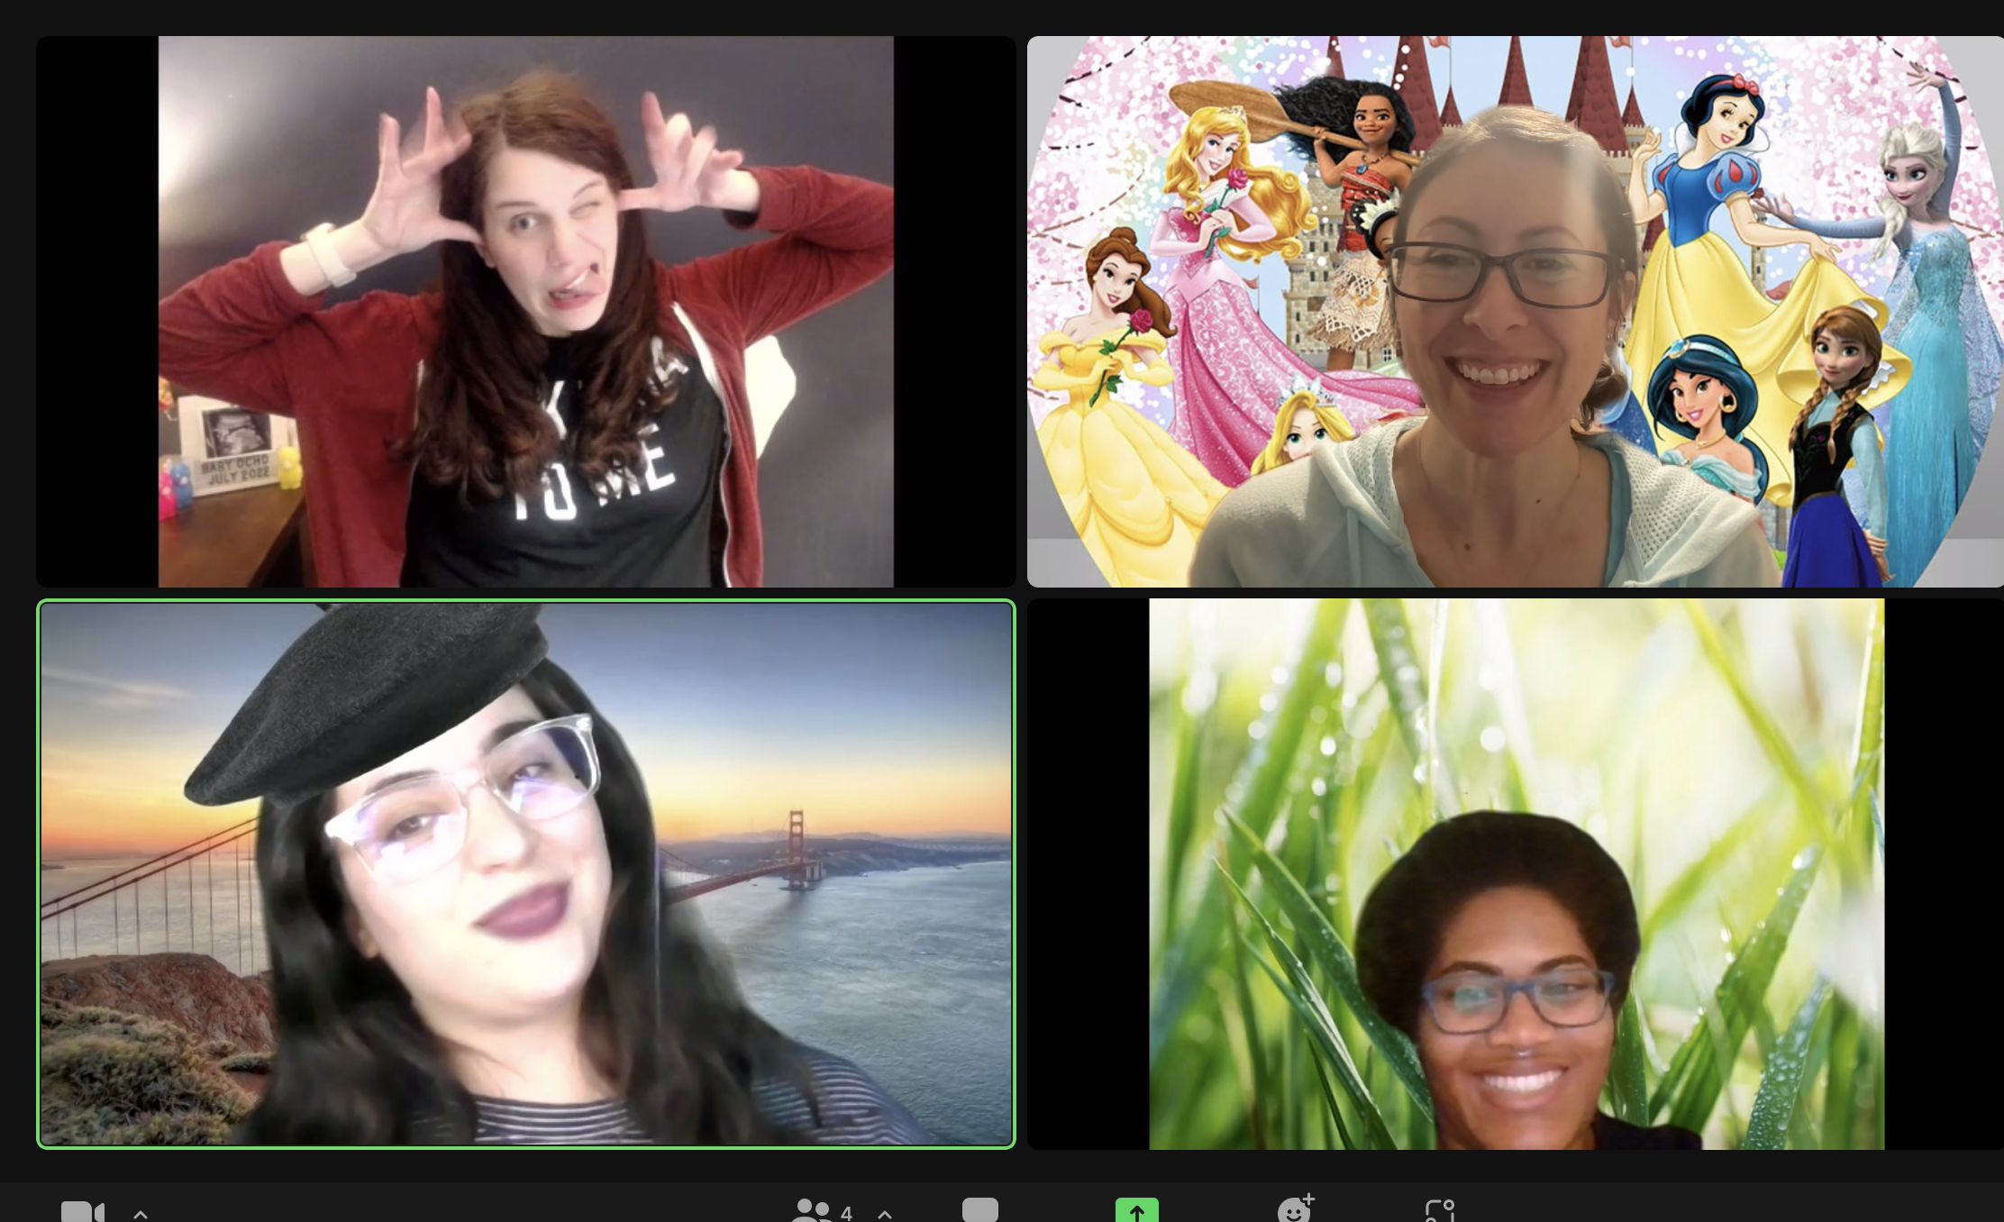
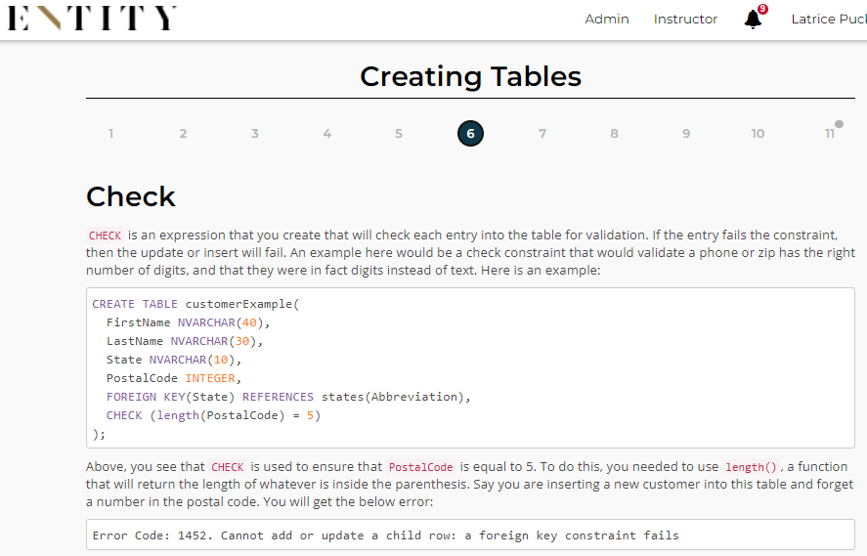
A Typical Day :Latrice
No excuse to jump into wrong class zoom, there is always either someone free to help them or doing an office hour on the class they need/ a video of the office hour ready to view!
For connect notes on who attended, they all comment on the slack notif, we take attendance on whos in for the day. Add that they zoomed with us in connect as normal.
6 DEDICATED CLASS HOURS:
review lesson pages at the pace they should be keeping
4 lessons due a week, 4 work days!!
quick lecture for 15 min, then take questions/ issues
[week 2] [lesson 2-5 due]
7 8 9 in am (lecture on front of lessons)
Slack time (4 hours)
LUNCH
7 8 9 in pm (lecture on end of lessons)
Post recorded OH (if needed?)

Slide 13
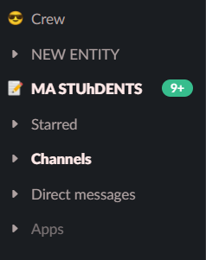
Better Team Communication
Check message notes from partner class mentor on behind/ failing students, retakes sent, etc, send a “update?” message to student to catch up
More mentors reaching student, keeps them honest
Basic LDA/ stand up meeting notes with each other
Slack sorted however you’d like (needy students get saved in group)

Slide 14
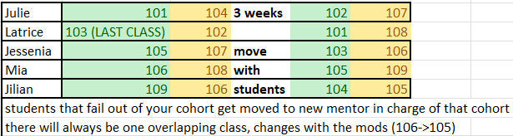
Similar Option
2-class-cohorts, move along with students, after class 9 (DS103), cycle back to DS101 (ALL of fresh cohort shared with opposite week mentor)
Stronger focus on TWO classes rather than three (must maintain 5+ mentors)
Stronger relationship with students, more group learning
Can do three office hours dedicated to two lessons vs. two dedicated to three L
Relearning the program in the same 9 months with students
Proposed better pass rates with more hands-on approach

Slide 15
EXTRA IDEAS!
A front of the week and back of the week mentor-pair that move in lessons together. Ex.Jilian always with Matt, Latrice always with Marcy? For better comms and setting up group chats with needy students for make up work, etc
Discuss each mentors role in class, focus on grading and getting make up exams? Focus on LDA attendance student follow-through?
Meet the Mentors video: we all talk about ourselves, how we liked the program, what DS means to us, our goals in DS.
Choco/ homebrew installs? Comp specs?
Welcome calls?
Try it out with one cohort meetings, then change it over to OH

